Slide 1
TSE6 - OpenCL
Part 2
Memory Model

Slide 2
Does GPGPU matter?
Facebook uses it for AI (Big Sur):
http://www.pcworld.com/article/3014321/hardware/facebook-makes-its-big-sur-ai-server-design-available-to-anyone.html
http://visionandrobotics.nl/2016/02/26/mark-zuckerberg-doneert-25-gpu-servers-voor-onderzoek-naar-machine-learning/
Google is making its own OpenCL/CUDA competitor (GPUCC)
https://www.phoronix.com/scan.php?page=news_item&px=GPUCC-CUDA-GPGPU-Comp
Google uses it for Machine Learning (deep learning; TensorFlow)
http://www.wired.com/2015/11/googles-open-source-ai-tensorflow-signals-fast-changing-hardware-world/
Amazon offers GPU computing on their EC2 platforms
http://docs.aws.amazon.com/AWSEC2/latest/UserGuide/using_cluster_computing.html
Microsoft will offer it soon in Azure
https://azure.microsoft.com/nl-nl/documentation/videos/azurecon-2015-applications-that-scale-using-gpu-compute/
GPU’s are used for self driving cars and drones
http://www.neurala.com/gpu-brains-drones-cars/
http://hackaday.com/2015/11/11/drones-are-getting-a-lot-smarter/
GPU’s and robotics
http://thepositive.com/robots-in-the-sky/
GPU’s in finance:
https://www.quora.com/What-are-potential-use-cases-for-GPUs-in-finance

Slide 3
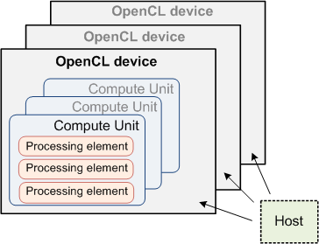
OpenCL Hardware Model
=GPU + memory
=core

Slide 4
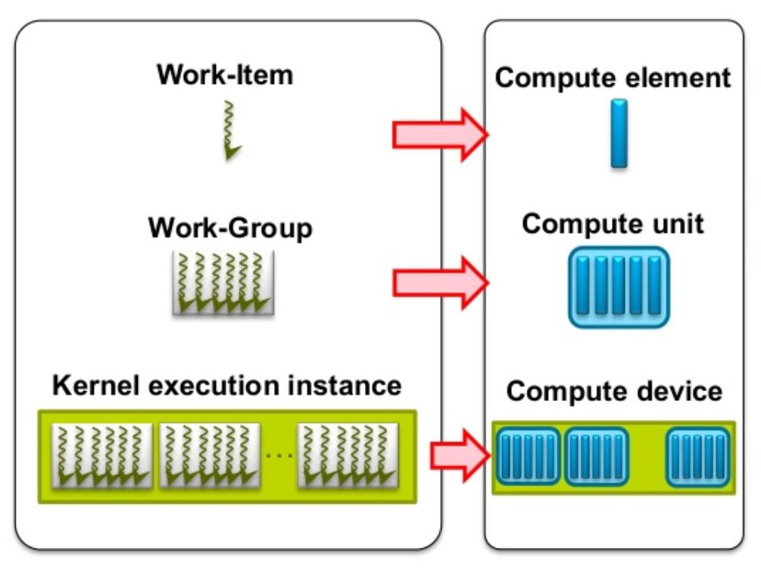
SW → HW mapping
Each Work Item (=Thread) is executed on a Processing Element (Compute Element)
Several Work Items can run on one Processing Element
Each Work Group is executed on a Compute Unit
Several Work Groups can run on one Compute Unit
Kernel is running on a Compute Device

Slide 5
Host and Device memory
On an average PC, there are 2 big distinct memory areas:
Host memory
The normal memory, that is used for any non-GPU program
Contains variables, stack, heap, etc
GPU can not use this; only CPU can
Device memory
Memory on the graphics card (“video memory”)
CPU can not use this; only GPU can
Both are connected, usually through a PCI-e bus
Relatively slow (like 8GBps)
Note: integrated (Intel) GPU shares memory with CPU

Slide 6
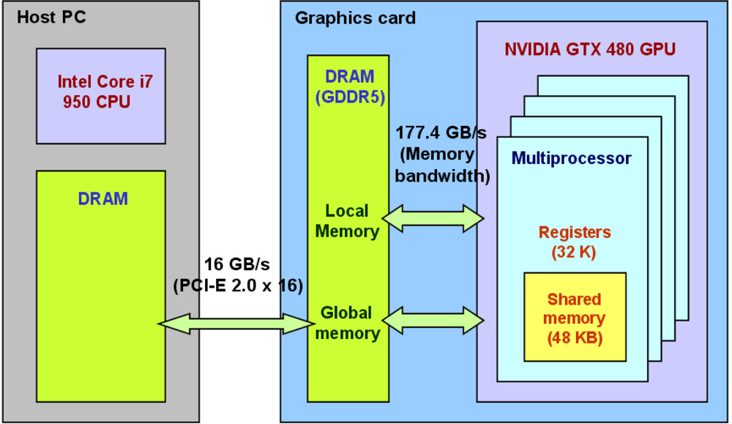
Example system

Slide 7
Host ↔GPU transfer can be bottleneck
Assume PCI transfer rate of 8 GB/s
Suppose we want to add two 1024x1024 matrices of ints
Size in bytes per matrix is 1024*1024*4 = 4 MB
Transfer 2 of these matrices to GPU:
Theoretical:
Two times 4 MB, at 8 GBps → 1 msec
Measured around 1.5 msec
Add the two matrices:
Theoretical:
1M additions with 1024 cores, at around 1 GHz → 0.001 msec
Moving all data from/to GPU DRAM, at 177 GBps → 0.070 msec
Measured around 0.800 msec
Transfer 1 matrix back to host:
4 MB, at 8 GBps → 0.5 msec

Slide 8
Transfer functions
There are special functions to copy data between host and GPU
Host → GPU
clEnqueueWriteBuffer
Puts a request to copy data from host to device in the queue
Will be executed when all previous commands are finished
GPU → Host
clEnqueueReadBuffer
Puts a request to copy data from device to host in the queue
Will be executed when all previous commands are finished
clEnqueueCopyBuffer will copy GPU → GPU

Slide 9
Mapping functions
With integrated GPU (usually Intel), GPU and CPU share the same memory → copying can be avoided (zero-copy buffer)
Then use the functions clEnqueueMapBuffer/ clEnqueueUnmapMemObject :
Some example code here:
http://stackoverflow.com/questions/19972445/whats-the-correct-and-most-efficient-way-to-use-mappedzero-copy-memory-mechan

Slide 10
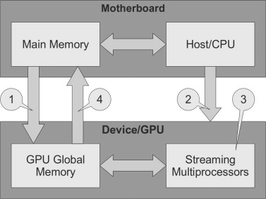
Design rule: Minimize transfers between host and GPU
Typical processing flow:
(1) Transfer data to GPU memory
(2) CPU sends instructions to GPU
(3) GPU processes data
(4) Transfer result to main memory
Device→Host and Host→Device involve (slow) DMA through PCIe, therefore:
Only transfer data if necessary
Combine operations on either CPU or GPU as much as possible
Might be more advantageous to run ‘slow’ operations also on GPU
Sequential execution on CPU might be faster than switching between GPU and CPU
Not always predictable, just try

Slide 11
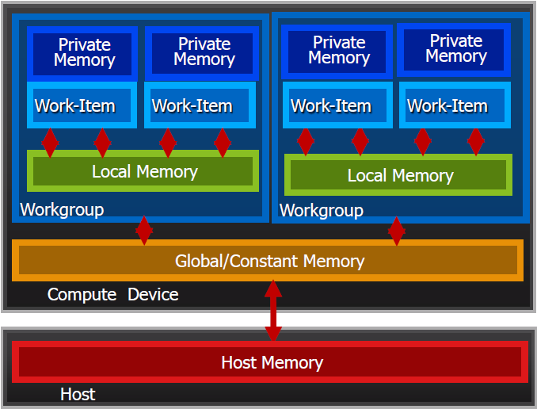
OpenCL SW Memory Model
In an OpenCL program, we can define several memory types
Private Memory
Per work-item
Local Memory
Shared within a workgroup
Global/Constant Memory
Shared between all workgroups
On the CPU
Host Memory
See also OpenCL Memory Spaces
Memory management is explicit
You must move data from host → global → local … and back

Slide 12
Mapping memory types on HW model
Private memory
Keyword __private or private
By default, local variables and arguments of a kernel are private
Allocated locally on the PE as much as possible
Very fast
Limited size!
When PE memory is full, remaining private variables are stored in global memory (slow!)
Local memory
Keyword __local or local
Allocated on the CU (Compute Unit)
Quite fast
Limited size

Slide 13
Mapping memory types on HW model
Global memory
Keyword __global or global
Allocated on device, outside of GPU chip, in video-memory
High latency (400 – 800 cycles)
Throughput around 177 GBps
Accelerated by using caches
Big
Constant memory
Keyword __constant or constant
Also allocated on device, outside of GPU chip, in video-memory
Read-only
Big
More about these qualifiers: link

Slide 14
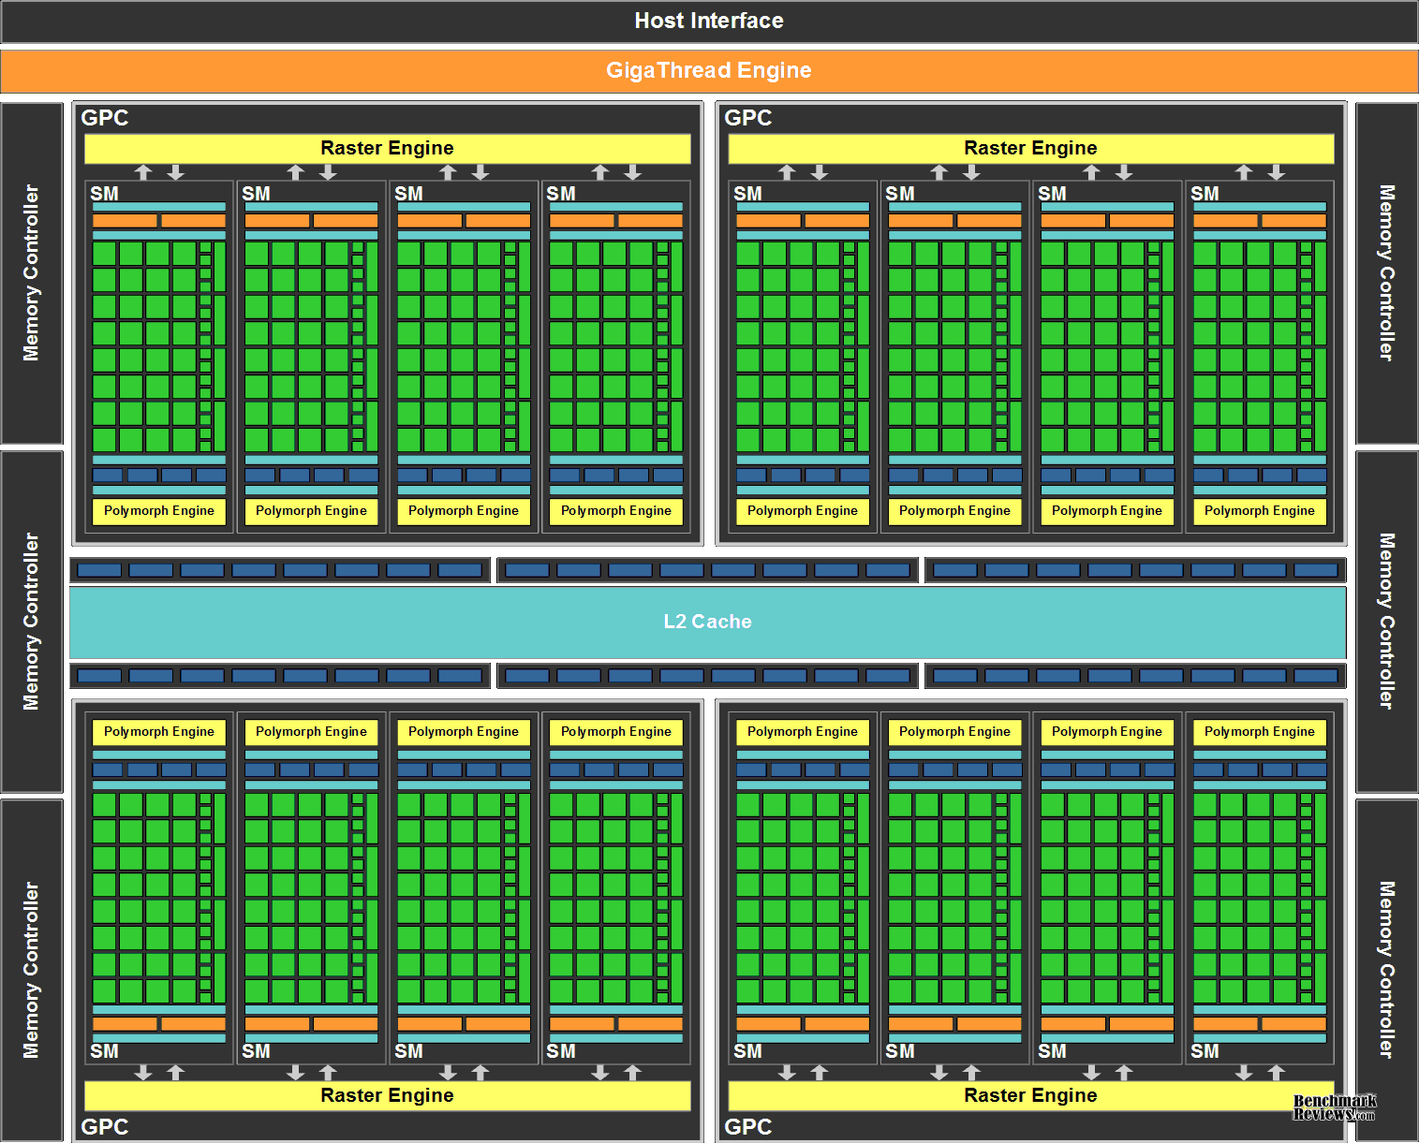
Example: nvidia Fermi memory
L2 cache on chip
768 kB
Non programmable
Shared between all SM’s
128 Byte cachelines
6 Memory Controllers for global memory
64 bits wide each, so 384 bit in total

Slide 15
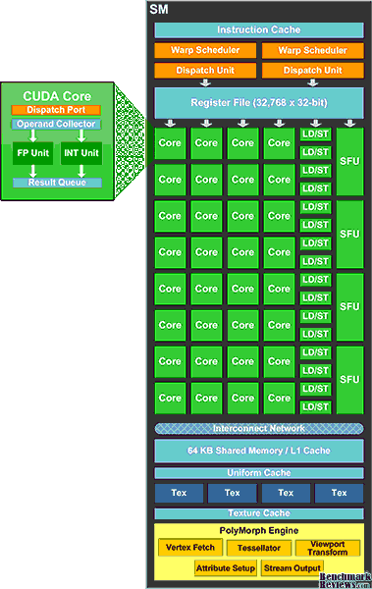
Example: nvidia Fermi memory
Per SM, there is 64 kB that can be used as Local Memory (=Shared Memory) and/or L1 cache
What about Private Memory:
A PE (=core) does not have its own memory
PE’s can use parts of the Register File as Private Memory (on average 4 kB per PE)
When Register File is full, rest of Private Memory is positioned in Global Memory

Slide 16
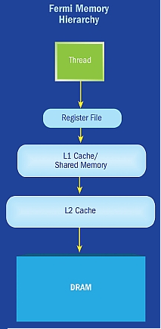
Path to memory
On Fermi, memory is divided in 6 partitions, that each have a 64-bit path
384 bit wide data path
6 accesses to different memory banks can be done in parallel
Accesses to the same memory bank have to be serialized
Consequences:
Let threads in a block access different memory banks
Caching

Slide 17
Measuring kernel execution time on CPU
Measure this on CPU in Windows with (e.g.) PerformanceCounter
LARGE_INTEGER freq, start; QueryPerformanceFrequency(&freq); QueryPerformanceCounter(&start); clEnqueueNDRangeKernel(......, &timing_event); clFinish(queue); LARGE_INTEGER end; QueryPerformanceCounter(&end); printf("Kernel execution took %lu milliseconds\n", (double)(end.QuadPart-start.QuadPart)/freq.QuadPart*1000.0);
Similar for buffer write, read, etc
Get time before kernel starts
Wait until the kernel is finished
Get time after kernel ends

Slide 18
Measuring kernel execution time on GPU
We can measure this on GPU by using events
cl_event timing_event; cl_ulong starttime, endtime; clEnqueueNDRangeKernel(......, &timing_event); clFinish(queue); clGetEventProfilingInfo(timing_event,CL_PROFILING_COMMAND_START, sizeof(cl_ulong),&starttime,NULL); clGetEventProfilingInfo(timing_event,CL_PROFILING_COMMAND_END, sizeof(cl_ulong),&endtime, NULL); printf("Kernel execution took %lu nanoseconds\n", endtime - starttime);
Similar for buffer write, read, etc
We must first enable profiling for this queue:
queue = clCreateCommandQueue(context, device, CL_QUEUE_PROFILING_ENABLE, &err);
Last argument of clEnqueue...
This event represents the kernel-run
Wait until the kernel is finished
When did the kernel start?
When did the kernel finish?

Slide 19
Useful links
Introduction in OpenCL: http://www.informit.com/articles/article.aspx?p=1732873
A bit old, but maybe still useful: https://anteru.net/2012/11/03/2009/
An introduction from AMD: http://developer.amd.com/tools-and-sdks/opencl-zone/opencl-resources/introductory-tutorial-to-opencl/

